Slide 1

Fake Job Posting Prediction
-Hinal Desai
ML51414

Slide 2
Contents
01
Problem Statement
05
GAN
Models
SVM
02
06
03
Data Pre-Processing
07
DECISION
04
BERT
08
Resources

Slide 3
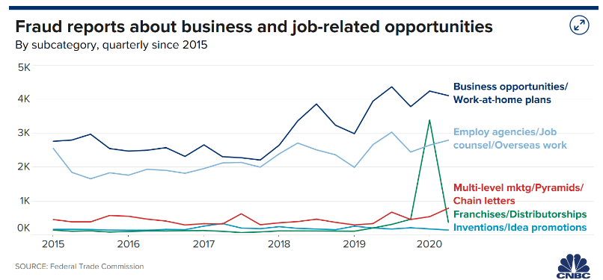
Problem Statement
Employment fraud is becoming more prevalent.
According to CNBC, there were twice as many employment frauds in 2018 as there were in 2017and it is ever increasing.
The state of the market today has resulted in substantial unemployment.
Many people are becoming victims of scammers who feed on their despair.

Slide 4
Models
BERT
Bidirectional Encoder Representations from Transformers
Machine Learning Models
GAN
Generative Adversarial Network
SVM
Support Vector Machine
SGD
Stochastic Gradient Descent

Slide 5
Data Pre-Processing
01
02
03
Merging
Tokenization
To Lower
Merge all the textual columns into one
The textual data is split into smaller units. In this case, the data is split into words.
The split words are converted to lowercase
04
05
Stopword removal
Lemmatization
Stopwords are words that do not add much meaning to sentences
Process of grouping together the different inflected forms of a word so they can be analyzed as a single item.

Slide 6
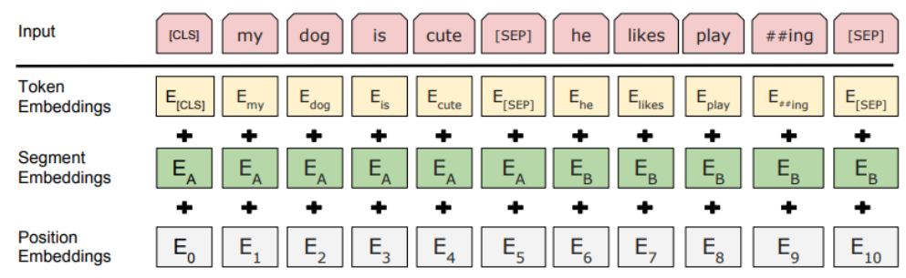
BERT
01
Makes use of Transformer Architecture
Consists to encoder and decoder
02
Applies BiDirectional Training of Transformer
Reads the entire sequence of words at once

Slide 7
BERT Pros and Cons
PROS
CONS
The model is large because of the training structure and corpus.
It is slow to train because it is big and there are a lot of weights to update.
It is expensive. It requires more computation because of its size, which comes at a cost.
It is designed to be input into other systems (not a standalone program), and because of that, it has to be fine-tuned for downstream tasks, which can be fussy.
Works well for task-specific models. The BERT model has been trained on a large corpus, making it easier for smaller, more defined tasks. Metrics can be fine-tuned and be used immediately.
The accuracy of the model is outstanding because it is frequently updated. You can achieve this with successful fine-tuning.
The BERT model is available and pre-trained in more than 100 languages. This can be useful for projects that are not English-based

Slide 8
GAN
Random Input Vector
A deep-learning-based generative model.
Generator-Discriminator Model
Generator goal: Maximize the likelihood that the discriminator misclassifies its output as real.
Discriminator goal: Optimize toward a goal of 0.5, where the discriminator can’t distinguish between real and generated images.
Examples of GANs: Naive Bayes, Latent Dirichlet Allocation(LDA), and the Gaussian Mixture Model(GMM.)
Generator Model
Generated Example
Real Example
Back Propagation: Maximize Error
Discriminator Model
Back Propagation: Minimize Error
Binary Classification
Real/Fake

Slide 9
GAN Pros and Cons
Advantages
Disadvantages
GANs generate data that looks similar to original data. If you give GAN an image then it will generate a new version of the image which looks similar to the original image. Similarly, it can generate different versions of the text, video, audio.
GANs go into details of data and can easily interpret into different versions so it is helpful in doing machine learning work.
By using GANs and machine learning we can easily recognize trees, street, bicyclist, person, and parked cars and also can calculate the distance between different objects.
Harder to train: You need to provide different types of data continuously to check if it works accurately or not.
Generating results from text or speech is very complex.

Slide 10
SVM
Plotting
Plot each data item as a point in n-dimensional space (where n is a number of features you have) with the value of each feature being the value of a particular coordinate.
Classification
Perform classification by finding the hyper-plane that differentiates the two classes very well
Kernel Trick
Classifying non-linear data by mapping the space to a higher dimension.

Slide 11
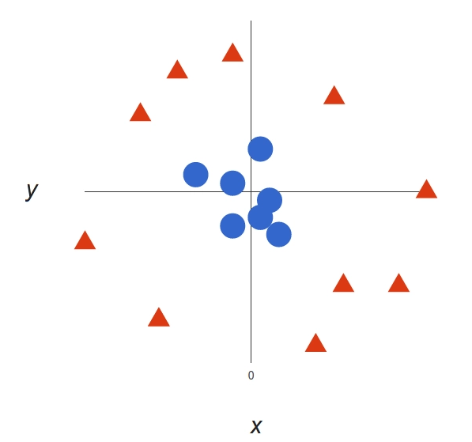
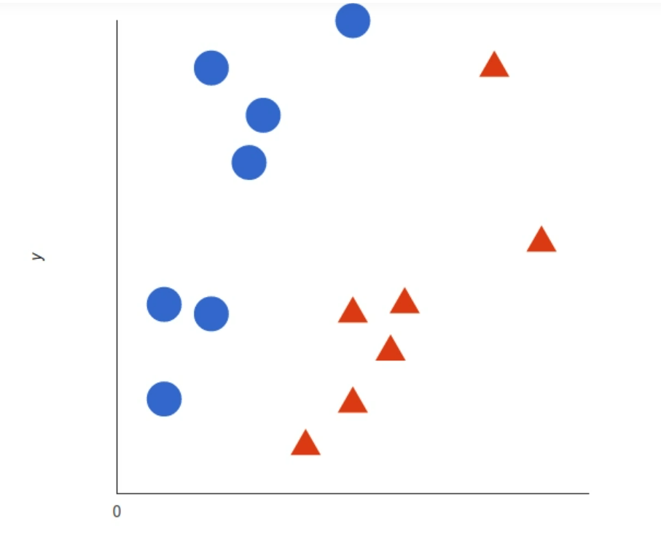
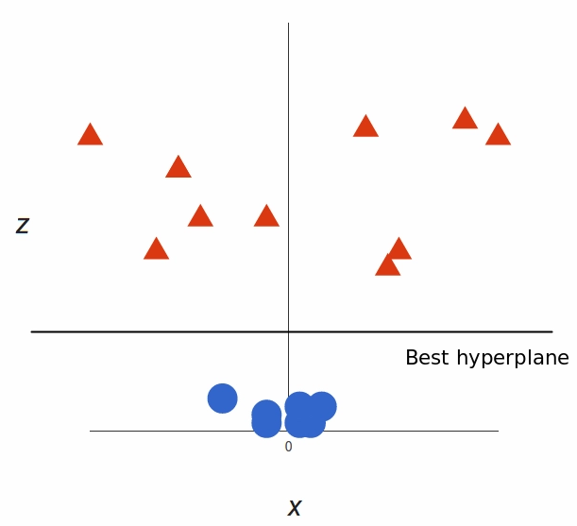
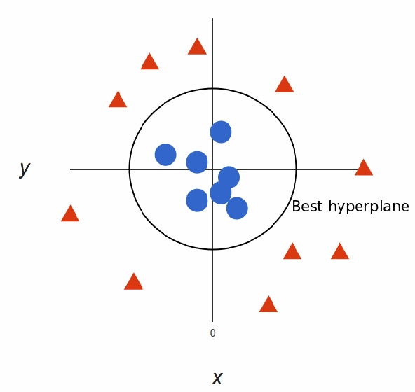
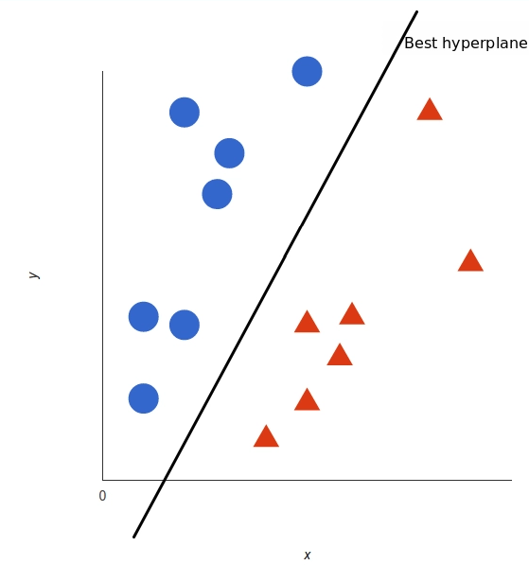
SVM Functioning Example
Linear Data Distribution
Non-Linear Data Distribution

Slide 12
SVM Pros and Cons
Advantages
Disadvantages
It works really well with a clear margin of separation.
It is effective in high dimensional spaces.
It is effective in cases where the number of dimensions is greater than the number of samples.
It uses a subset of training points in the decision function (called support vectors), so it is also memory efficient.
It doesn’t perform well when we have large data set because the required training time is higher.
It also doesn’t perform very well, when the data set has more noise i.e. target classes are overlapping.
SVM doesn’t directly provide probability estimates, these are calculated using an expensive five-fold cross-validation.

Slide 13
Decision
This metric produces a ratio of all correctly categorized data points to all data points. This is particularly useful since we are trying to identify both real and fake jobs, unlike a scenario where only one category is essential.
Decision on which model fits best is based on 2 criteria
01
Accuracy
Accuracy =
True Positive + True Negative
True Positive + False Positive + False Negative + True Negative
F1 score is a measure of a model’s accuracy on a dataset. F1-score is used because, in this scenario, both false negatives and false positives are crucial. This model needs to identify both categories with the highest possible score since both have high costs.
02
F1-Score
F₁ =
True Positive
True Positive +1/2( False Positive + False Negative )

Slide 14
References
https://towardsdatascience.com/bert-explained-state-of-the-art-language-model-for-nlp-f8b21a9b6270
https://www.analyticsvidhya.com/blog/2019/09/demystifying-bert-groundbreaking-nlp-framework/
https://www.projectpro.io/article/bert-nlp-model-explained/558
https://medium.com/@Packt_Pub/inside-the-generative-adversarial-networks-gan-architecture-2435afbd6b3b
https://www.itrelease.com/2020/06/advantages-and-disadvantages-of-generative-adversarial-networks-gan/
https://www.analyticsvidhya.com/blog/2017/09/understaing-support-vector-machine-example-code/
https://monkeylearn.com/blog/introduction-to-support-vector-machines-svm/

Slide 15
QUESTIONS ?

